Slide 1
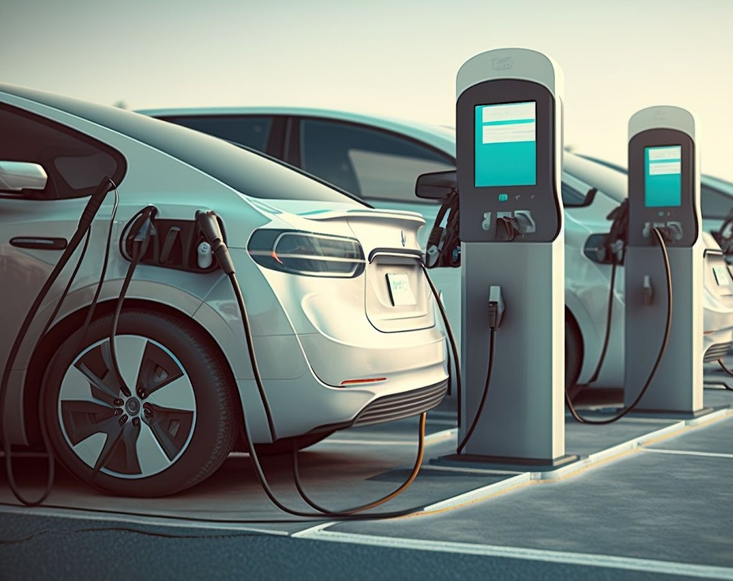
Electric Vehicle Charge Finder
- Manjurekha Badiger

Slide 2

EV Charge Finder
The EV Charge Finder app is designed to help electric vehicle owners locate nearby charging stations, view availability, and get directions to the selected stations.
The app aims to provide a user-friendly interface with real-time data to enhance the EV charging experience.
As world is looking towards EV. Production and market towards EV is increased and in coming years it will be challenging to produce EV for an automobile industries, so designing an app for EV customers for making them easy hazel free charging.
With this App EV owners can easily find nearby available charging station and with connector/plug types. This apps developed as mobility services for all EV Customers.
Targeted Group: EV customers, EV Battery Manufacturers & Automobile Industries

Slide 3
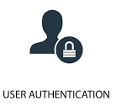
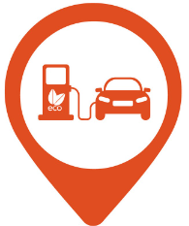

Product Features
User Authentication: Allow users to sign up and log in securely to access the app's features.
Map Interface: Display a map interface using a mapping API (e.g., Google Maps) to show the locations of EV charging stations.
Search Functionality: Implement search functionality for users to find charging stations based on their current location or specified address.
Filtering Options: Allow users to filter charging stations by criteria such as charging speed, availability and connector type (e.g., CHAdeMO, CCS, Type 2).
Charging Station Details: Provide detailed information about each charging station, including address, operating hours, supported connector types, and availability status.
Real-time Data Updates: Integrate with charging station APIs or networks to fetch real-time data on station availability, including the number of available chargers.
Favorites : Enable users to save their favorite charging stations for quick access.

Slide 4
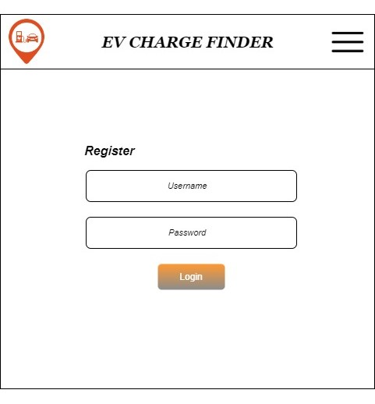
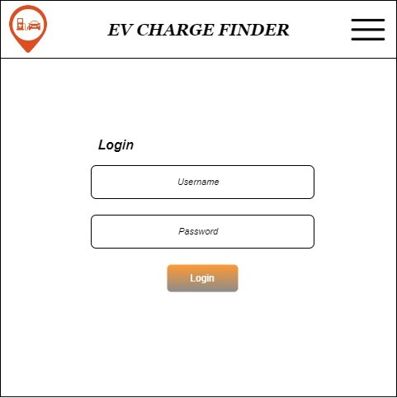
Register & Login
Endpoint :
~/auth/register-user/{username}/{password}
Endpoint : ~/auth/getToken/{username}/{password}

Slide 5
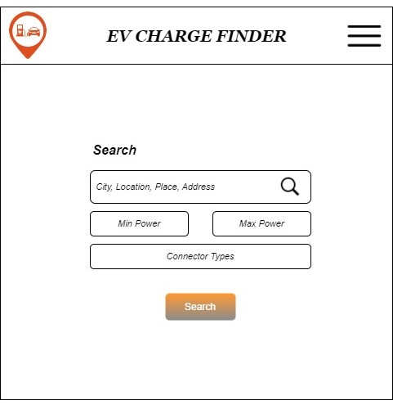
Search
Endpoint :
~/search/ChargingStation
Payload :
{
“query” : “hisings backa”,
“connectorType”:””,
“minPower”:””,
“maxPower”:””
}

Slide 6
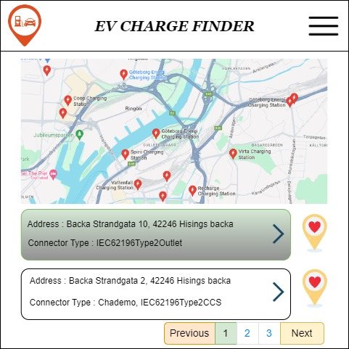
Search Result
Response :
{
"id" : "-IJe4arStDRVnOdBq9iXOA" ,
"address" : {
"streetNumber" : "10" ,
"streetName" : "Backa Strandgata" ,
"municipality" : "Greater Gothenburg" ,
"countrySubdivision" : "Västra Götaland County" ,
"countrySubdivisionName" : "Västra Götaland County" ,
"countrySubdivisionCode" : "O" ,
"postalCode" : "422 46" ,
"countryCode" : "SE" ,
"country" : "Sweden" ,
"countryCodeISO3" : "SWE" ,
"freeformAddress" : "Backa Strandgata 10, 422 46 Hisings Backa" ,
"localName" : "Hisings Backa" ,
"municipalitySubdivision" : "Gothenburg"
},
"chargingPark" : {
"connectors" : [
{
"connectorType" : "IEC62196Type2Outlet" ,
"ratedPowerKW" : 22 ,
"voltageV" : 230 ,
"currentA" : 32 ,
"currentType" : "AC3"
}
]
}
}

Slide 7
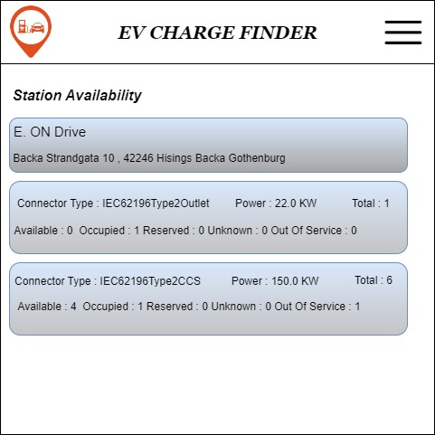
User Favorite Station
Station Availability
Endpoint : ~/userfav/save
Payload : {“userToken”:””,”chargingStationID”:””}
Endpoint : ~/search/ChargingStationAvailability/{chargingstationID}

Slide 8
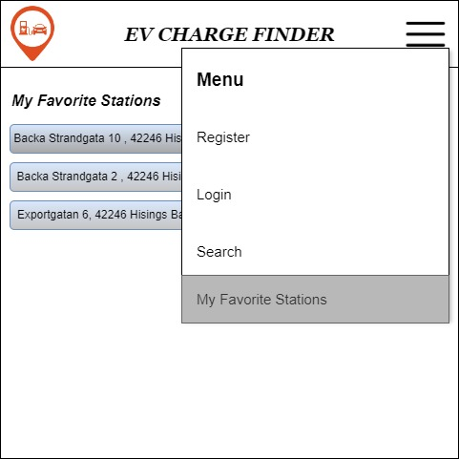
My Favorite Stations
Endpoint :
~/userfav/UserFavStations
Payload :
{ “userToken” : “”}

Slide 9
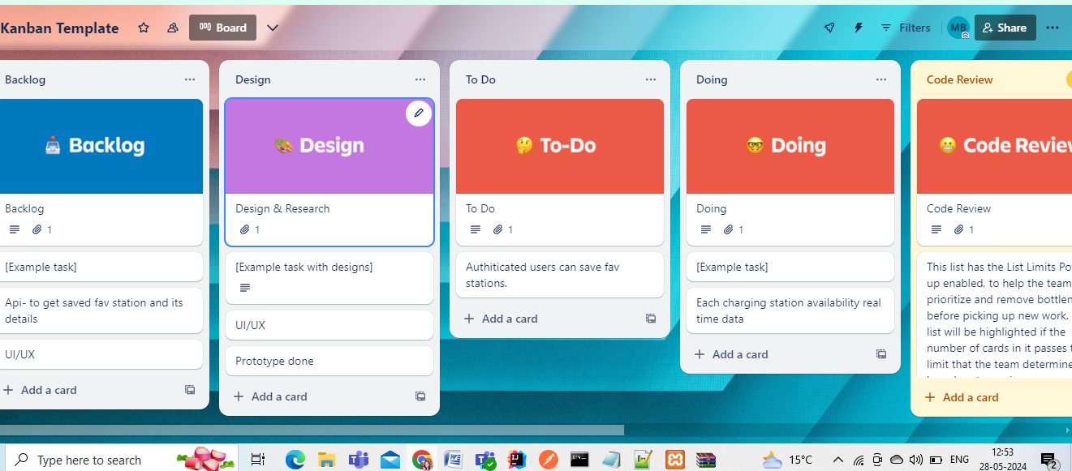
Agile Kanban

Slide 10
Tasks in Kanban
Define technical requirements
Document user stories and use cases.
Design wireframes and mockups
Define navigation flow.
Creating github repo to keep code connectivity and branching out the tasks.
Set up development environment.
Create collection for Third party API in Postman.
Test Third Party APIs
Design MySQL DB Schema.
Developing & Testing User Auth API (Register & Login) feature.
Developing & Testing Search & Station Availability features.
Developing & Testing Save & Get User Favorite Stations.

Slide 11
References
TomTom Developer – https://developer.tomtom.com

